Slide 1
SUPPORT VECTOR MACHINES PRACTICAL

Slide 2
Hyper parameter Tuning
C float, default=1.0
Regularization parameter. The strength of the regularization is inversely proportional to C. Must be strictly positive.
kernel{‘linear’, ‘poly’, ‘rbf’, ‘sigmoid’, ‘precomputed’}, default=’rbf’
Specifies the kernel type to be used in the algorithm. It must be one of ‘linear’, ‘poly’, ‘rbf’, ‘sigmoid’, ‘precomputed’ or a callable. If none is given, ‘rbf’ will be used.
Degree int, default=3
Degree of the polynomial kernel function (‘poly’). Ignored by all other kernels.
gamma{‘scale’, ‘auto’} or float, default=’scale’

Slide 3
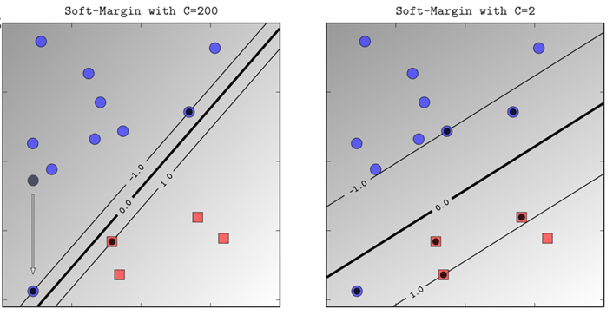
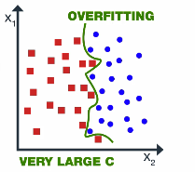
Hyper parameter Tuning
Regularization parameter (C)
Penalty term (Regularization)
Trade-off between classifying training data points accurately and margin
Higher value of C leads to small margin and overfitting
Notes:
https://www.analyticsvidhya.com/blog/2021/06/support-vector-machine-better-understanding/

Slide 4
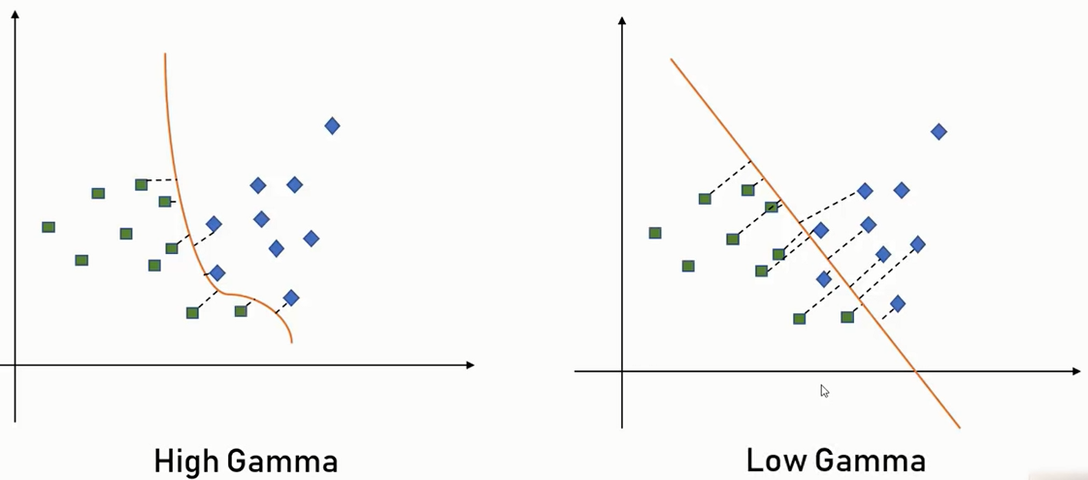
Hyper parameter Tuning
Gamma parameter (C)
Used in RBF kernel
Decides impact of nearest training points in prediction.
High gamma makes closer observation as more influential so decision boundary gets more curved
Low gamma makes closer observation as less influential so decision boundary gets more smooth
Notes:
https://www.analyticsvidhya.com/blog/2021/06/support-vector-machine-better-understanding/
https://www.youtube.com/watch?v=FB5EdxAGxQg

Slide 5
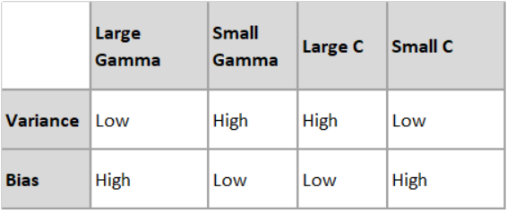
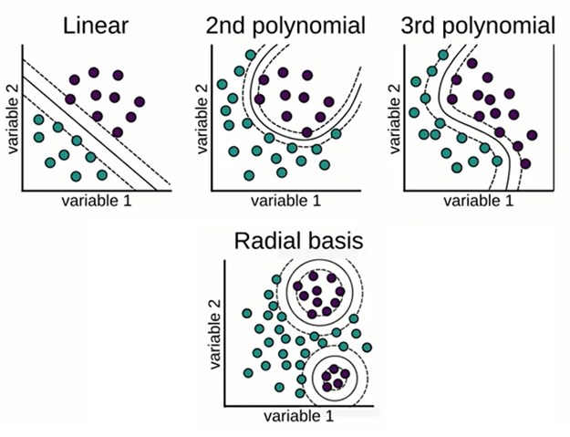
Hyper parameter Tuning
Time of SVM learning: linear < poly < rbf
Ability to fit any data: linear < poly < rbf
Risk of overfitting: linear < poly < rbf
Risk of underfitting: rbf < poly < linear
we should start with linear kernel and try other kernels
if performance is not good.
Notes:
https://www.youtube.com/watch?v=0QNXhZKwUII
https://stackoverflow.com/questions/33778297/support-vector-machine-kernel-types
https://www.analyticsvidhya.com/blog/2021/06/support-vector-machine-better-understanding/
https://www.quora.com/Why-does-RBF-kernel-generally-outperforms-linear-or-polynomial-kernels?utm_medium=organic&utm_source=google_rich_qa&utm_campaign=google_rich_qa

Slide 6
SVM
When to use SVM
When N < 100000 (when your data is large then use tree based ensembles). It is very heavy algorithm, since it requires all of the samples in N*N matrix for kernel computation. Also, try to reduce dimension.
When data is sparse such as text data DTM
If data is unstructured (image/audio) use deep learning for complex learning rather than SVM
Notes:
https://www.youtube.com/watch?v=IlPmT-TtkZo

